Slide 1
10 Things That Someone Will Pay For Later
Jeff Putz

Slide 2
About Me
Code monkey since 1999-ish (formerly a top-40 DJ, pays as poorly as you think)
Mostly a MSFT stack guy these days, but a “web guy” since before it was cool.
Can’t get away from forums… author of POP Forums, worked on MSDN Forums.
Run a site for roller coaster nerds called CoasterBuzz.
Currently: Technical Architect at AgileThought.
Previously: SeaWorld Parks & Entertainment, Humana, Microsoft, Insurance.com, many contract gigs

Slide 3
“Always strive for the minimum viable product and keep it simple…
But don’t do stupid things that are crazy expensive down the road.”
-Me

Slide 4


Slide 5
1. Poor or excessive project organization

Slide 6
1. Poor or excessive project organization
“Agile” does not mean process-free.
Silos, walls, kingdoms, bunkers, doors, etc. will get in the way.
You need a product owner.
Having 40 people required to sign-off on something does not add value. (And no, SOx compliance doesn’t require it either.)
Lengthy design and specification phases are throw-away, lead to missed expectations.

Slide 7
2. Naming stuff with names No One but you understand

Slide 8
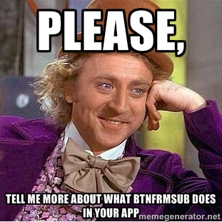

Slide 9
2. Naming stuff with names no one but you understand
Hungarian notation.
IDE tooling is where you discover types.
Use names that are descriptive.
Stick to conventions that make sense (like the “generator” in “UnicornGenerator.”
Be specific and not general. Prefer BostonTerrierGroomer to DogGroomer.

Slide 10
3. Dependencies on hard system boundaries

Slide 11

snowmads.com

Slide 12
3. Dependencies on hard system boundaries
Database, file system, network services, etc.
Use dependency injection, even “poor man’s” DI, so you can test and diagnose chunks of code in isolation.
If your solution requires outside environments to be active in order to develop, you’re doing it wrong.
Having to set up a local database is one thing, but requiring developers to have access to local folders, web services, etc., makes it expensive to ramp up new people.
Bonus pile of awesome: Build instrumentation around your system boundaries (measure latency, response times, failures, contextual information).

Slide 13
4. Mixing real-time and pre-calculated business rules to output data

Slide 14
4. Mixing real-time and pre-calculated business rules to output data
Imagine if you will, a report generated on an ad hoc basis.
Now imagine that the data that feeds the report is based on data that is already calculated.
You have to anticipate upstream and downstream effects.
Issues are often hidden without integration tests.
Pre-calculated data is great for performance, but don’t derive data from derived data.

Slide 15
5. Testing all of the wrong things

Slide 16
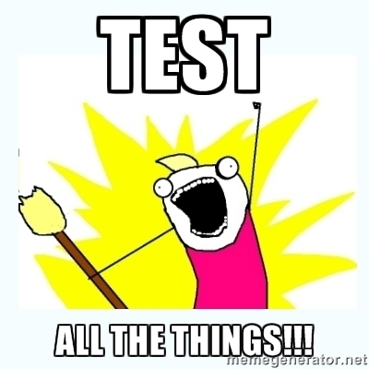

Slide 17
5. Testing all of the wrong things
return _dependentThing.Method() does not need a unit test.
If you need to test an existing framework or library in the context of your app, you’re testing the wrong thing. (Hint: MVC is pretty well tested already.)
Having to test leaky abstractions by way of really complicated setup is a design problem (think ORM context mocks).
Unit test to exercise each logical path through a single method.
Integration tests where they make sense.
Functional testing if you can afford it.
Automate, automate, automate!

Slide 18
6. Putting off refactoring on something clearly broken

Slide 19
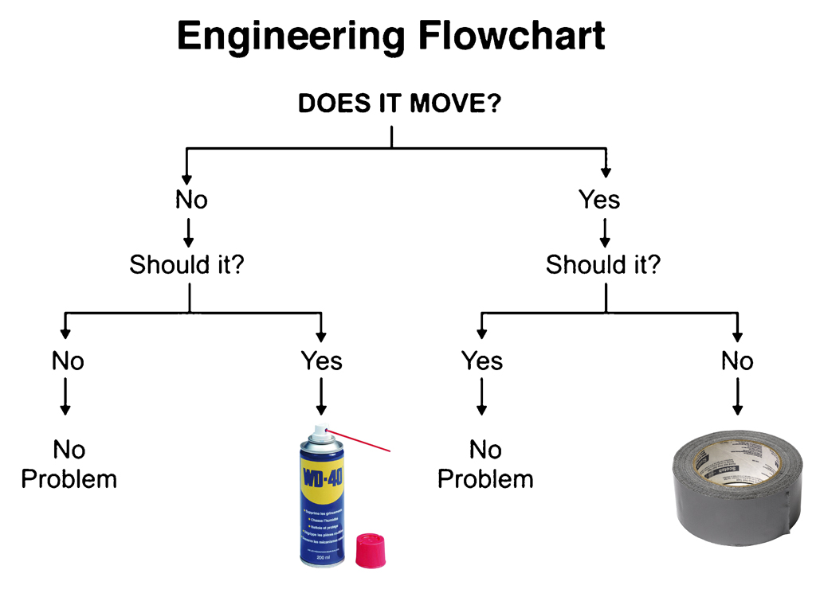

Slide 20
6. Putting off refactoring on something clearly broken
Technical debt is real for any application that has a shelf life.
The more time passes, the less likely the context of the problem will be well known.
Stakeholders must be made to understand that maintainability and performance are in fact features, even if they can’t click on it. (This is an expectation you have to set early on.)
You don’t have to (and shouldn’t) do premature optimization, but don’t do premature sabotage by introducing poor decisions early on.

Slide 21
7. Libraries, packages and poor source control

Slide 22
7. Libraries, packages and poor source control
No really, you need source control.
Consider a distributed version control system like Git or Hg, because it encourages more experimentation as each developer can branch and merge.
Make “library” references sparingly, consider internal package management servers.
Don’t make packages library references. It’s harder to update them or specify certain versions.

Slide 23
8. The guy with context was hit by a bus

Slide 24


Slide 25
8. The guy with context was hit by a bus
If you rely on a subject matter expert (SME), make sure that they’re not the only one on the planet.
Right-size your documentation (if there’s any at all).
Good test coverage means more transparent context.
Don’t let a developer become a dependency that can hold the business hostage.

Slide 26
9. Classes that are a thousand lines long

Slide 27
9. Classes that are a thousand lines long
Beware the monolith.
Huge classes do too much, are hard to decipher.
They’re impossible to unit test because there are no obvious units.
Logic goes several layers deep, is difficult to understand.
Often requires context from original developer.
No clear business rules.

Slide 28
10. Hard to replicate environments

Slide 29
10. Hard to replicate environments
If a new developer requires more than an hour to clone and run a project, that’s too long.
An app dependent on external resources should have stubs as part of its solution. (Double true if you work in an agency for external clients.)
Remember that there is a cost associated with tools, frameworks and data stores that aren’t typically on a dev’s machine (in ramp up time and skill development).
Automate things like seed data and configuration, and commit it to source control.

Slide 30
Questions?

Slide 31
Find me
http://weblogs.asp.net/jeff
jeff@popw.com
@jeffputz
Open source: http://popforums.com

